Slide 1
Maze Game Exit Logic Bug Fix
Zyad Shehadeh

Slide 2
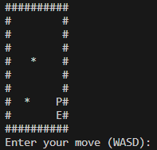
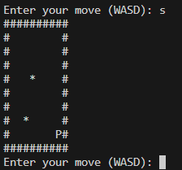
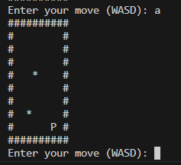
Issue: Exit Symbol Overwrite
Addressed a bug where the player's position could overwrite the exit symbol (EXIT), preventing the game from recognizing the exit and concluding the game properly.

Slide 3


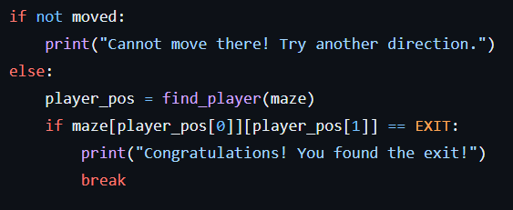
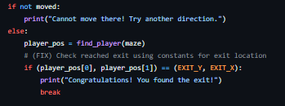
Solution: Change Exit Detection Logic
Introduced Constants for Exit Position: Refactored the hardcoded exit position with constants EXIT_X and EXIT_Y, ensuring the exit is always placed consistently and simplifying the check for reaching the exit.
Updated Exit Detection Logic: Modified the exit detection logic to use the constants EXIT_X and EXIT_Y. This change prevents the player from continuing past the exit due to the overwritten exit symbol issue.

Slide 4
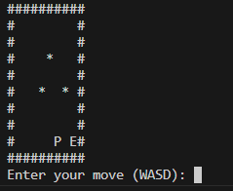
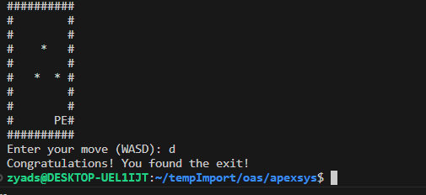
Conclusion: Gameplay Works as Expected
Improved Gameplay Flow: Players can now reach the exit without being able to continue moving, leading to a proper conclusion of the game with a congratulatory message.

